Slide 1
Enforcement and Compliance History Online (ECHO) Biosolids Facility Search

Slide 2
Agenda
Biosolids Program and ECHO
ECHO Biosolids Universe
ECHO Biosolids Search Results
ECHO Biosolids Annual Report Data Download
Known Issues, User Feedback, and Planned Updates
Demo and Questions

Slide 3
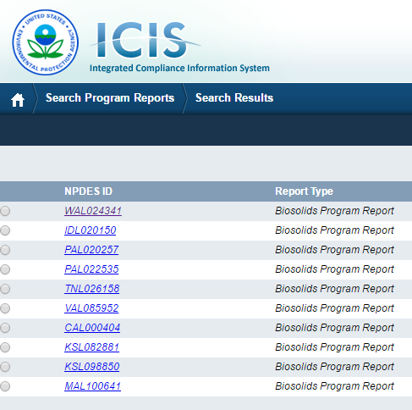
Biosolids Program
Prior to the implementation of the NPDES eReporting Rule (eRule), Biosolids Annual Reports were submitted on paper with varying data quality. Paper submissions limited the data availability and utility of biosolids data on a national scale.
With the implementation of the eRule, the 2016 Biosolids Annual Reports were required to be submitted electronically* in the 42 states where EPA implements the Federal Biosolids Program. Most of these data are stored in ICIS and are not publically available.
Notes:
*An estimated 700 papers reports for 2016 were submitted to R7 of varying data quality.

Slide 4
How can ECHO help?
EPA’s Enforcement and Compliance History Online (ECHO), which provides integrated compliance and enforcement information for over 800,000 regulated facilities, includes a new Biosolids Facility Search that allows for customized search, sort, and download of biosolids data for the first time.
The search is available to the public and centralizes biosolids program information (annual reports submitted electronically, compliance monitoring, and enforcement data) into an easy-to-use search tool.
ECHO features are regularly updated to meet stakeholder’s data needs.

Slide 5
Who is Included in the Biosolids Search?
ECHO’s Biosolids Universe
NPDES ID Submitted Annual Report (NeT)
NPDES ID with Biosolids Permit Component
NPDES ID has ‘L’ in 3rd Character
NPDES ID has Biosolids Violation
NPDES ID has Biosolids Inspection
NPDES ID has Biosolids Enforcement Action
ECHO’s Biosolids Search returns one row of data in the results table for each unique NPDES ID in its biosolids universe

Slide 6
What is Included in the Biosolids Search?
Biosolids Permit Data
Biosolids Annual Report Data Submitted Electronically
Biosolids Inspections
Biosolids Single Event Violations (SEVs)
Biosolids Informal and Formal Enforcement Actions
Biosolids Penalties

Slide 7
What is NOT Included in the Biosolids Search?
Biosolids pollutant concentration data – upcoming release
2016 Biosolids Annual Report data submitted in paper form, but ECHO includes a list of facilities that submitted in paper form
Biosolids generation and management data prior to 2016 because of low data quality

Slide 8
Biosolids Annual Report Data Download
Full download of Biosolids Annual Report data is available from ECHO’s Data Downloads page
Advantages
Review and analyze data by management practice
Updates weekly with ECHO data refresh
Limitations
Restricted to Biosolids Annual Report data, i.e., not integrated with other biosolids permit information – but could be in the future

Slide 9
Known Issues
Biosolids violations cannot yet be seen in the Facility-Level Status of the DFR - upcoming release
New NPDES IDs created for biosolids permits and some FRS issues make it appear like there are multiple entries in ECHO’s search results table for a single facility
Ability to duplicate some search criteria on form – does not affect search results

Slide 10
User Feedback
Limit search form to only biosolids specific data and add ‘Biosolids’ to all labels to distinguish them
Add alert to users that search criteria specific to Biosolids Annual Report eliminates the biosolids universe that did not submit an annual report
Add list of facilities who submitted 2016 Biosolids Annual Reports in paper form
Add pollutant concentration data

Slide 11
Planned Updates
Create Biosolids Facility Report to allow users to view biosolids program summary data at a single facility
Include pollutant monitoring data included in the Biosolids Annual Reports

